Slide 1
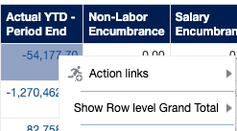
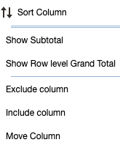
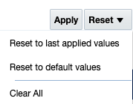
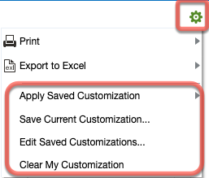
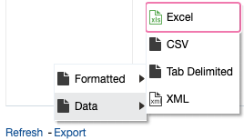
System Requirements
Use Chrome / Edge / Firefox for best results
Finance Dashboard designed for 27” screen
iO Dashboard Tool Kit
There are 5 key dashboards for the iO community: My Teams, Purchasing and Payments, Finance (including 3 payroll views), and 2 versions of the Sponsored Projects/Faculty Funds (SPFF): PI SPFF for a big picture view and Administrator SPFF for details. This guide explains various tools available that might not be obvious, but greatly facilitate your data management and analysis. This side is for basics; the reverse shows advanced features and notes for specific dashboards. First, let’s cover the most important rule: Dashboard Rule #5 Although many have tried, you can’t break me, so explore, explore, explore. If you get stuck, see the Troubleshooting section below.
Filters or Prompts – narrow your data set
Select values only for the filters you need
If you select a person name AND a division AND a department, iO is looking for all 3 of those, not the one or the other
Type directly over Select Value or select the down arrow for a list.
Select one or multiple boxes to add values to your search.
To further refine your search, select Search or More/Search at the bottom of the value list.
Highlight the items in the left-hand column you want to include and use the right arrow key (>) to move into the Selected column on the right.
Use the double right arrow key (>>) to move everything.
To see everything except a few values, move everything to the right, highlight the items to exclude and move them to the left.
Select Apply to activate your search.
Drill Down for Details
(financial dashboards)
Blue text is drillable for more details
Select to drill or right click to see a content menu
A new view opens in a new browser tab
Navigate to your original page using the browser
Switch between multiple tabs for convenience
For faster performance, close tabs not in use
Customize your Data View
using the Context Menu (Right Click)
To access the context or “right click” menu, hover over the column you want to act on, and right click. Here’s a great example of Rule #5 to explore: Select Exclude column. Now look for that column under Include Column to add it back in. What else can you do?
Need definitions or information?
Look for these links to additional information above the dashboard title or in the dashboard menu
Guides provide an explanation of the data filters and common uses for the various views found on the dashboard.
Troubleshooting Steps – in this order
Refresh dashboard using Gear or Export menu (at bottom of screen)
Clear cache on browser
Clear customizations
Reset to default values
Restart dashboard
Restart Browser
Best Practice – to ensure access to the latest dashboard features, always access dashboards through iO tiles rather than a bookmarked link.
Saving your Custom View
using the Gear Menu
Located at the top right of your dashboard
Save and name
On your next visit, Apply
What is captured?
All filters you have applied including dates / fiscal periods
All changes to the data table (exclude, include, move columns; subtotals, sorts)
Best Practice – review filters after applying a customization to know what your data set includes
If new features added to the dashboard, customizations won’t include them.
Options for Exporting data
1) Gear menu at top right of screen
2) Export option at bottom of table
Unformatted data or flat file: Export to Excel
Formatted view: Print
Training Resources
For additional training resources, start with the OGL widget or the Learning module within iO.
Other resources are available at iOEvolution.rice.edu/training catalog.
Unformatted data file for pivot tables: Data > Excel or CSV
Formatted view: Formatted> PDF or Excel
Updated January 30, 2024
For additional assistance, please visit iOEvolutiOn.rice.edu

Slide 2
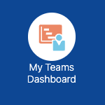
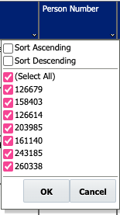
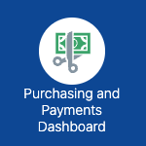
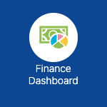
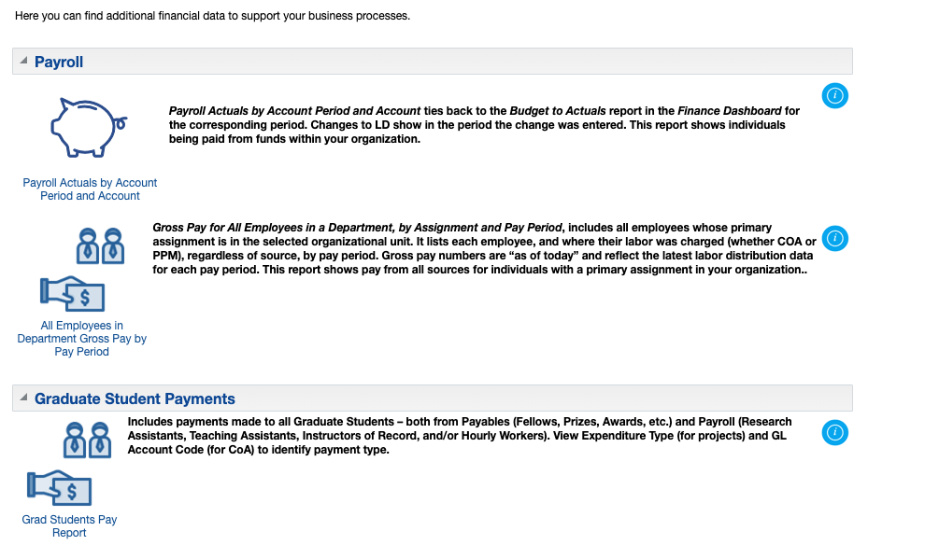
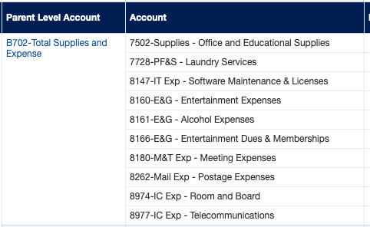
Special Notices
Look for these tips and notices on the dashboards
iO Dashboard Tool Kit
Dashboard Data Update schedule: SPFF Dashboards and Finance Dashboard – except Wages and Payments tabs – update overnight. P2P, My Teams and Wages & Payments dashboards (Finance) update throughout the day. The screenshots below show what report views are available on each of the dashboards. Add your own notes to personalize this document. For an editable version of this document, search iO Dashboard Tool Kit in the iO Training Catalog.
My Teams Dashboard reports and the Wages and Fellow Payments report on the Finance Dashboard provide Excel-like filters within the data table. Hover over the column you want to act on, and right click to activate the context menu.
Notes:
Finance Dashboard Filters now provide filtering by all hierarchy levels. View the full hierarchy by searching All Oracle Values in the iO Training Catalog. This is an example of the new Total Supplies and Expense Parent Level B hierarchy. Select B702 in the Account filter to see only those accounts.
Best Practice:
Use only one hierarchy level per filter.
2) You may use multiple filters at
different hierarchy levels.
e.g. Org Filter at transactional level (no letter) and Account level B.
Updated January 30, 2024
For additional assistance, please visit iOEvolutiOn.rice.edu

